Slide 1
2023/2024
Data Analysis and Integration Project Presentation
Diogo Clemente dos Santos 99200
Ana Carolina Baptista 95529

Slide 2
01

Slide 3
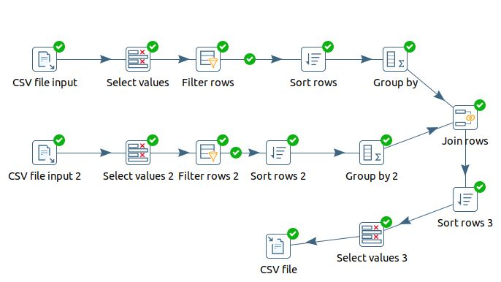
Transformation

Slide 4
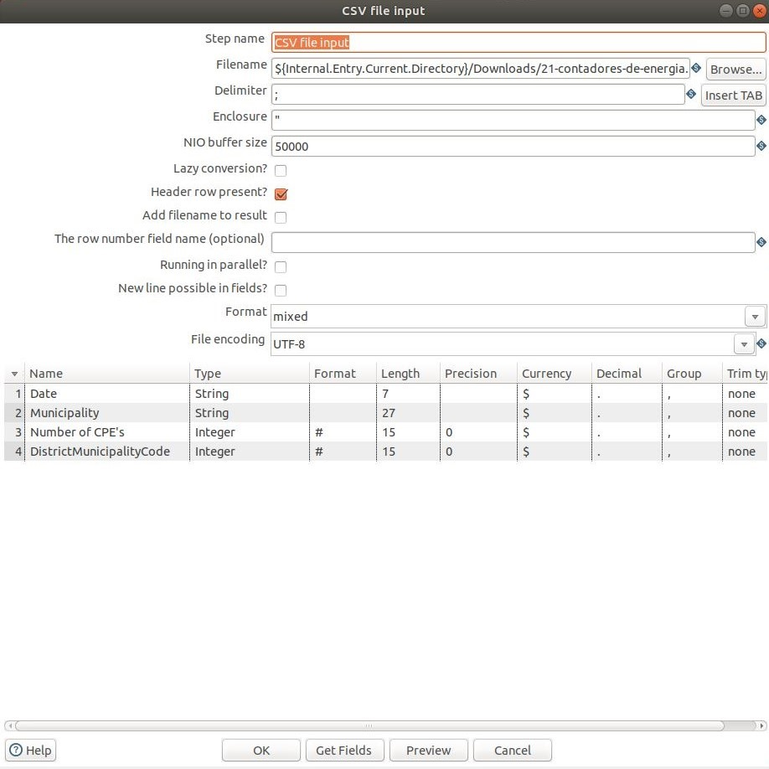
CSV file input

Slide 5
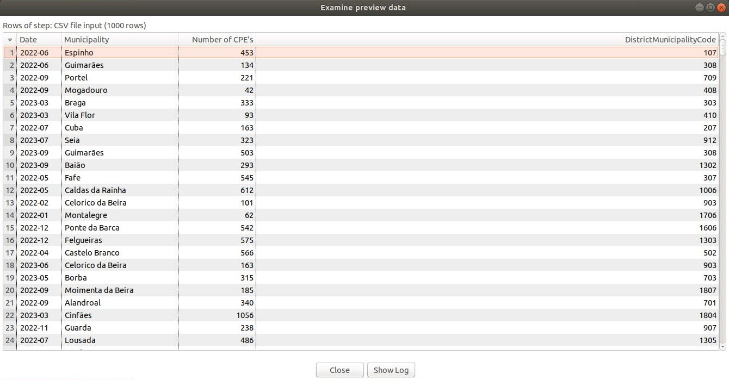
CSV file input

Slide 6
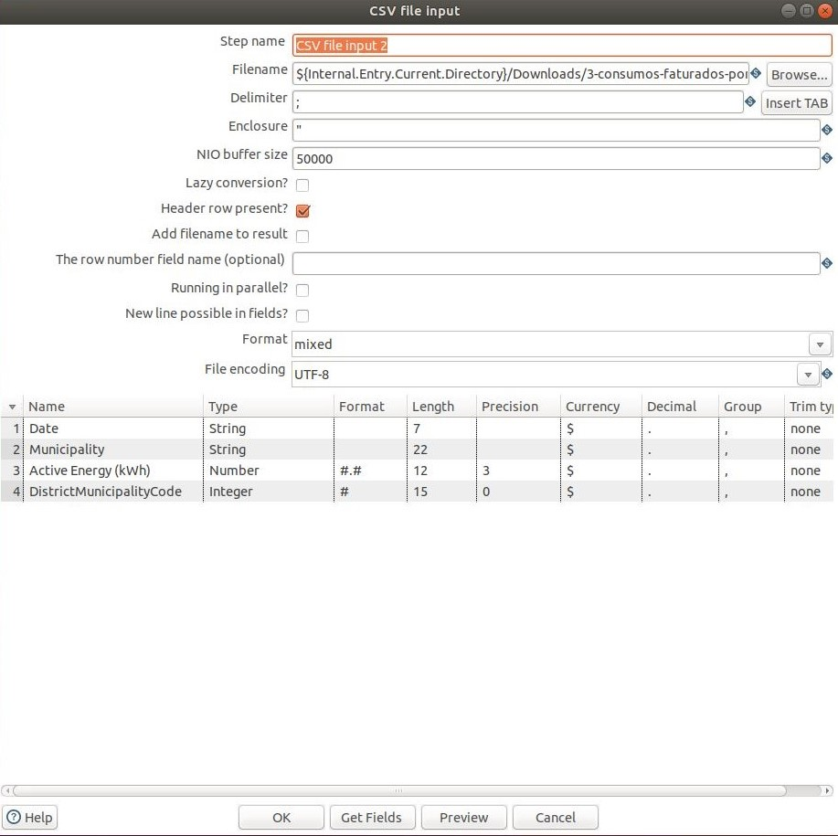
CSV file input 2

Slide 7
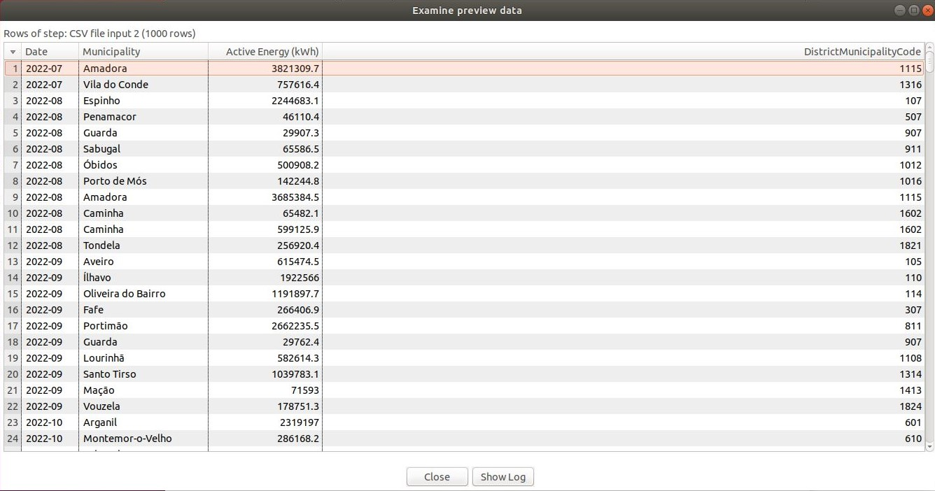
CSV file input 2

Slide 8
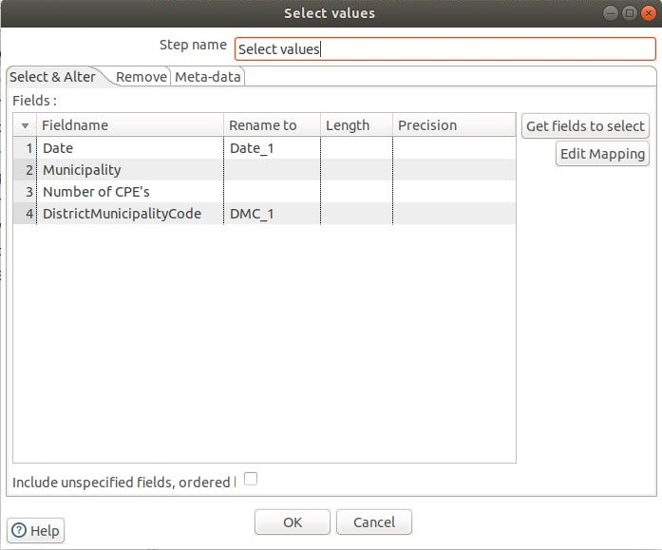
Select values

Slide 9
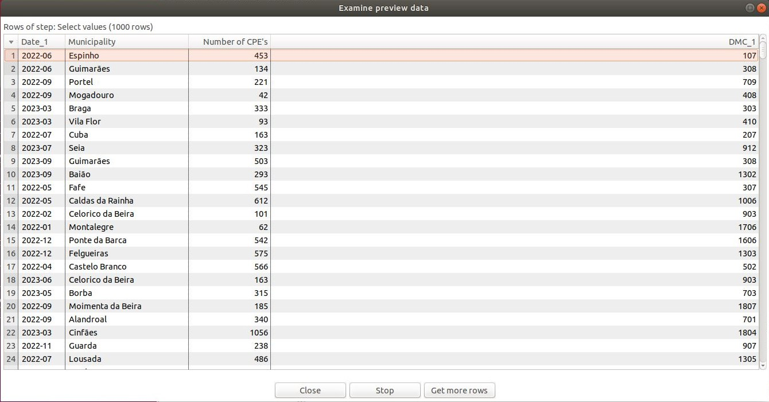
Select values

Slide 10
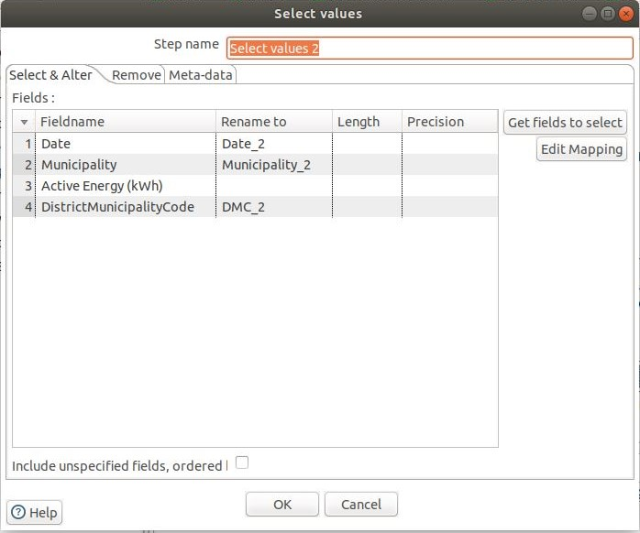
Select values 2

Slide 11
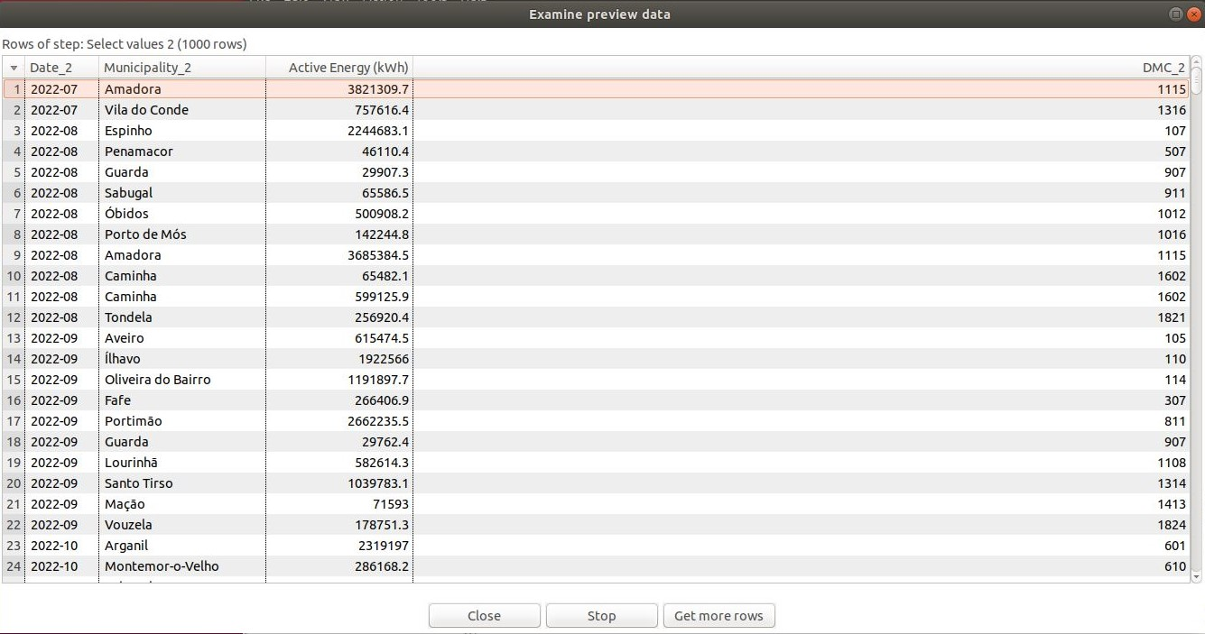
Select values 2

Slide 12
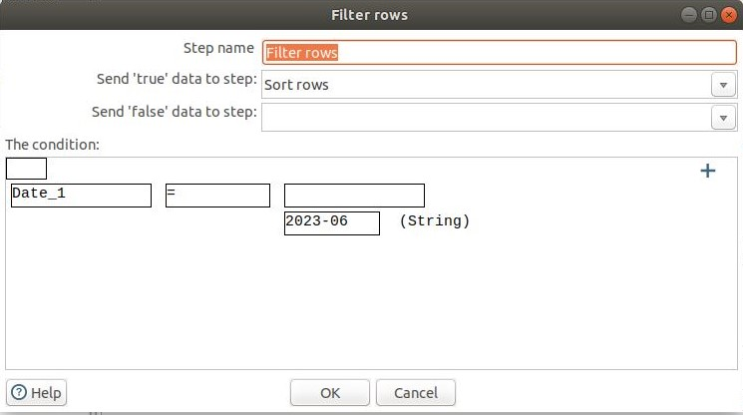
Filter rows

Slide 13
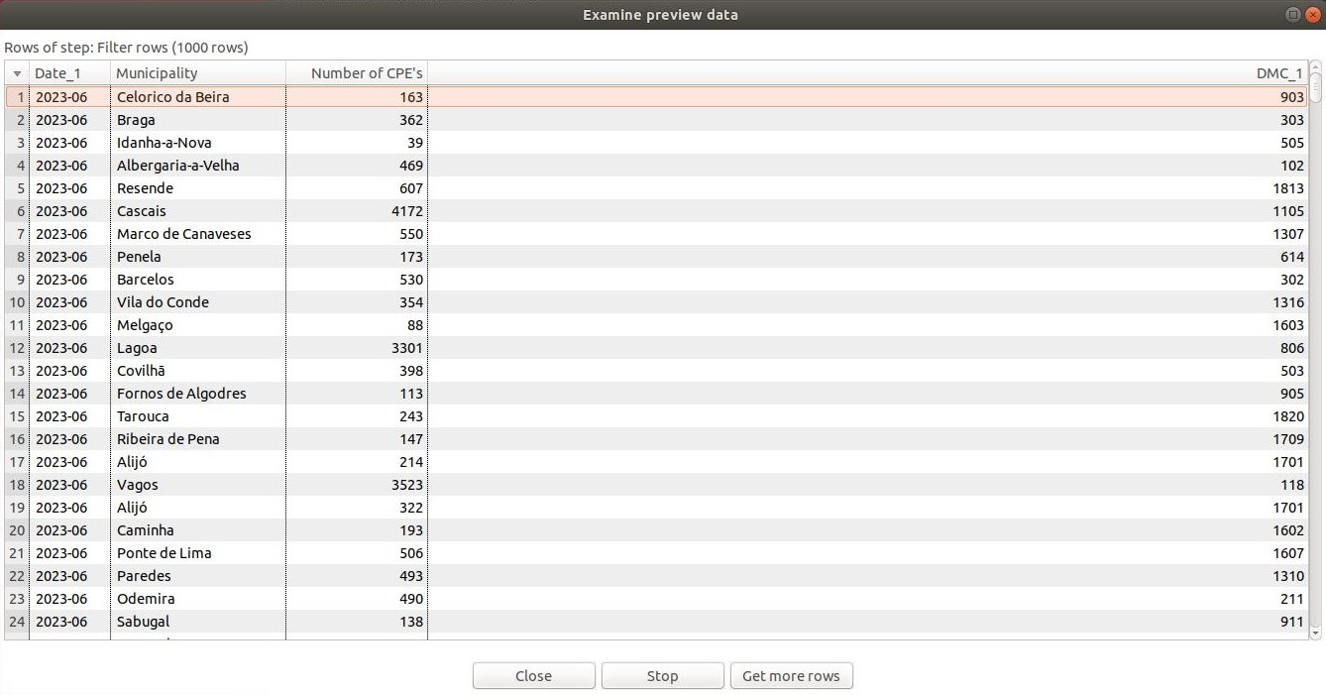
Filter rows

Slide 14

Filter rows 2

Slide 15
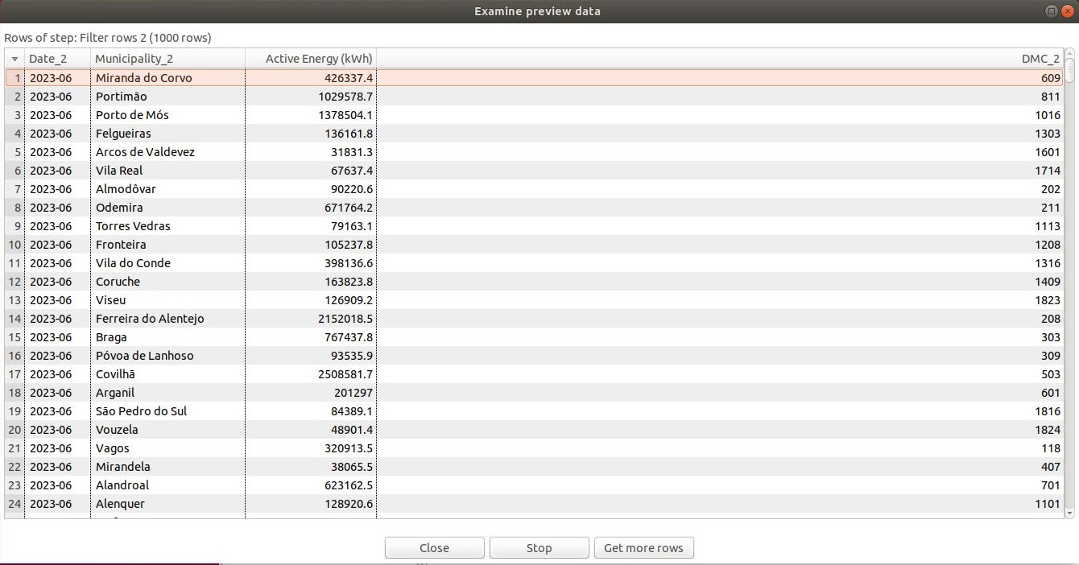
Filter rows 2

Slide 16
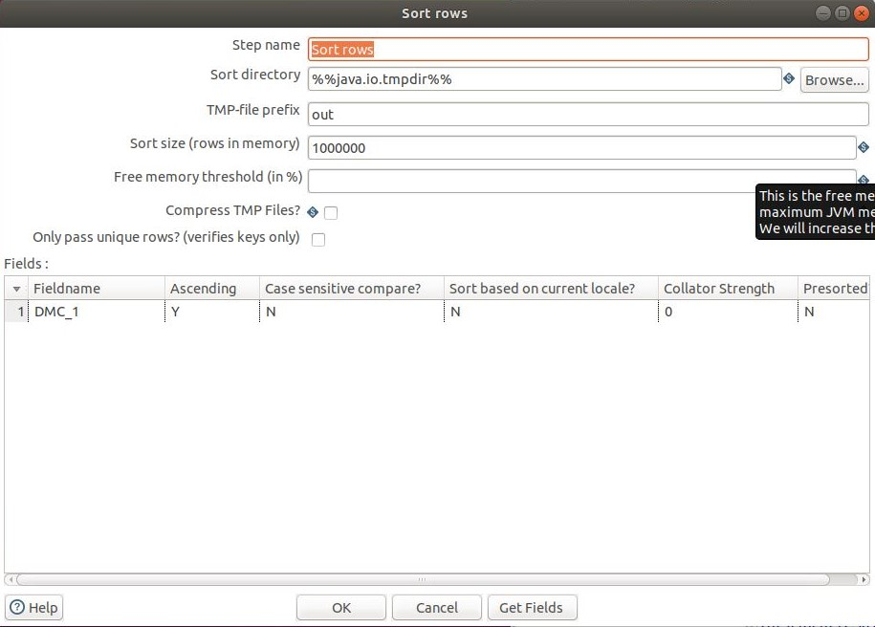
Sort rows

Slide 17
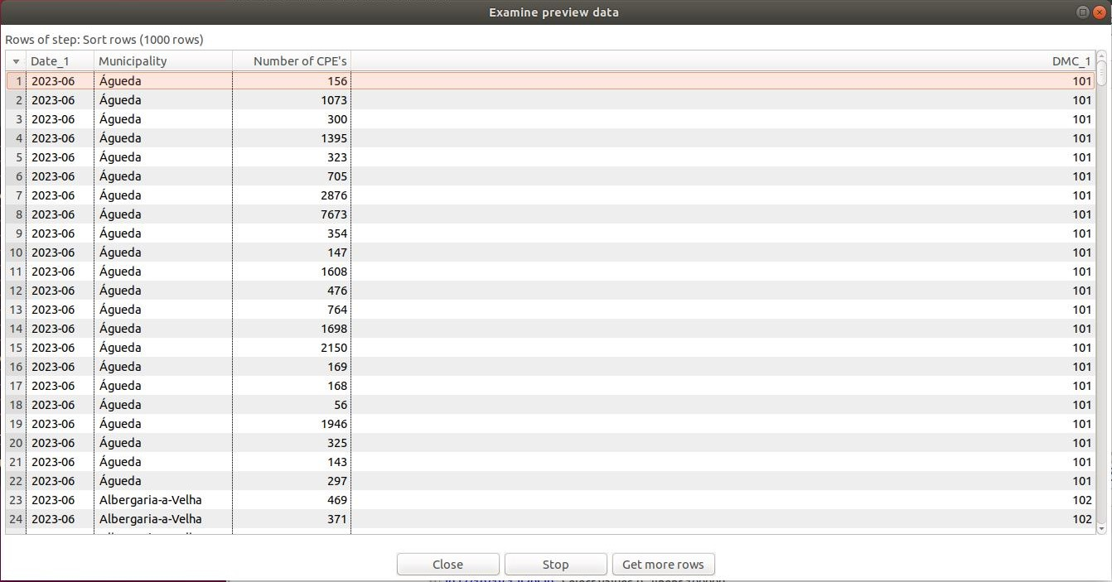
Sort rows

Slide 18
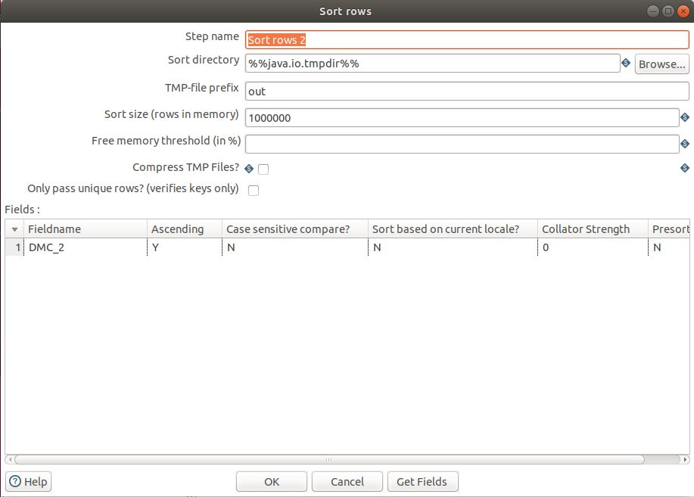
Sort rows 2

Slide 19
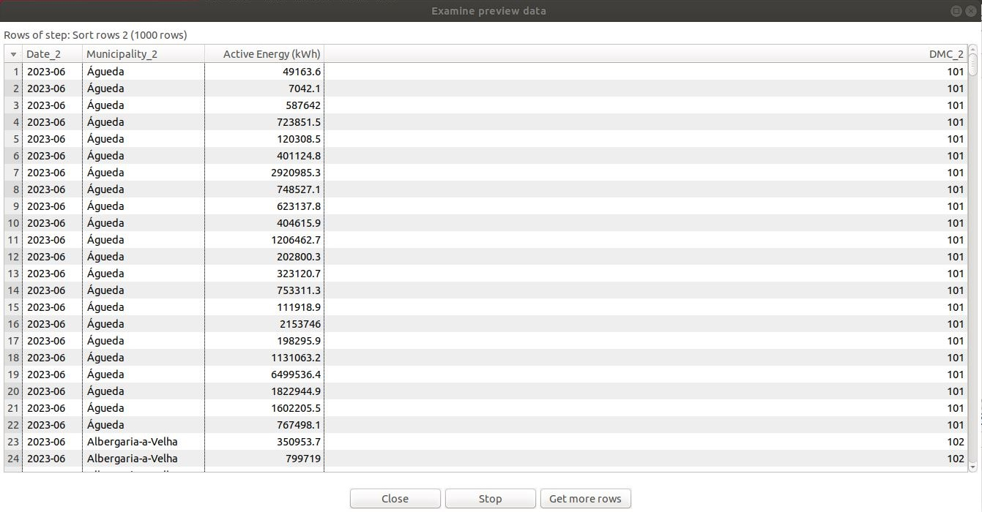
Sort rows 2

Slide 20
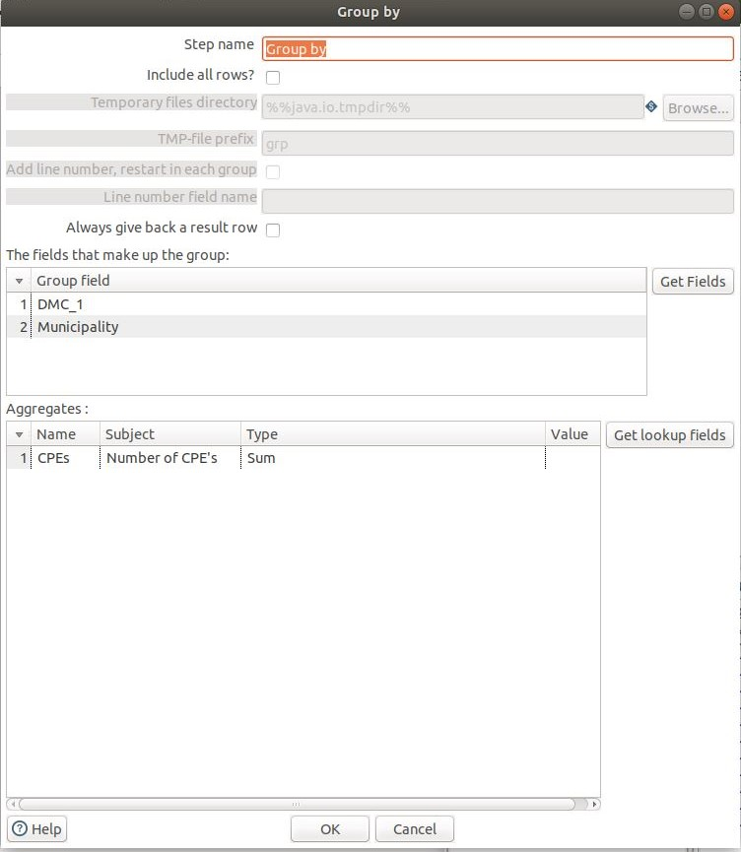
Group by

Slide 21
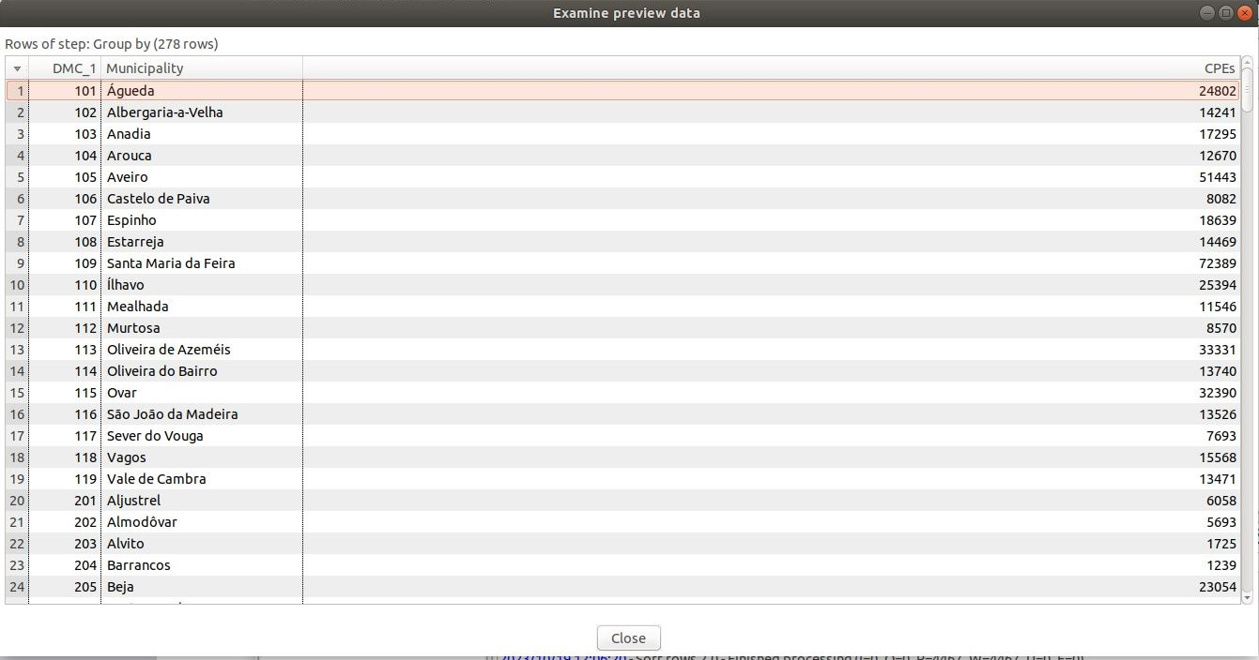
Group by

Slide 22
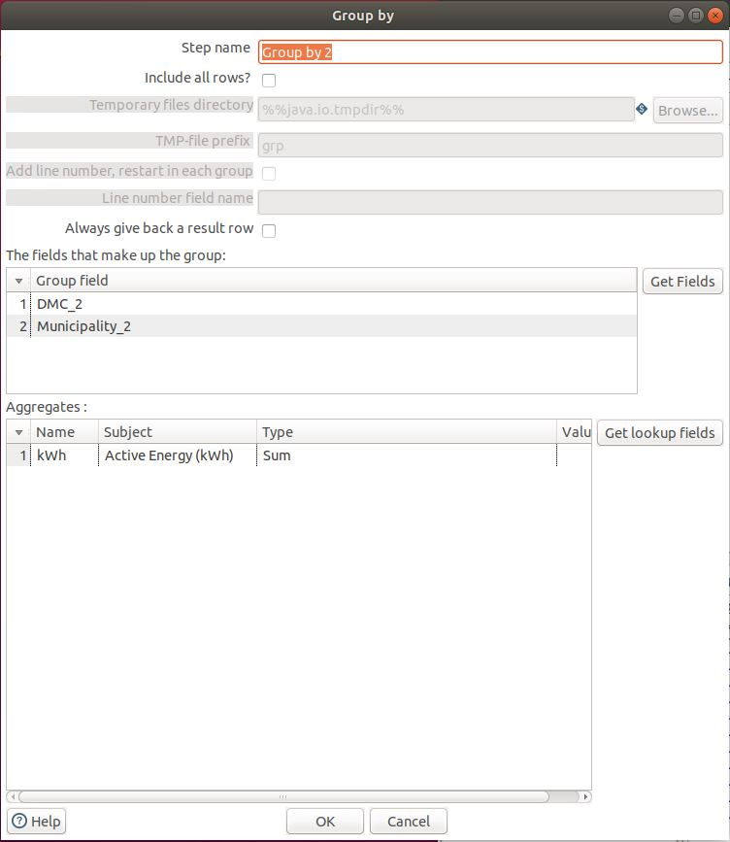
Group by 2

Slide 23
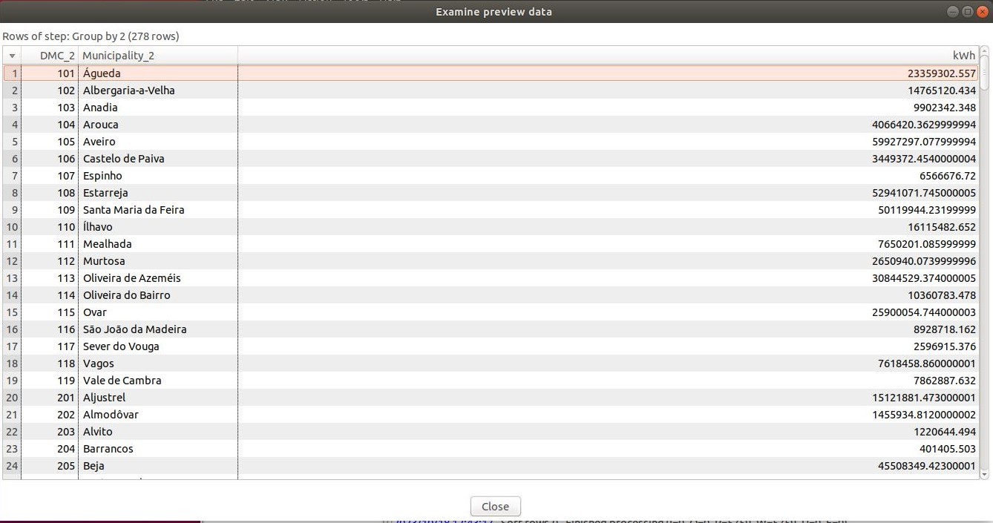
Group by 2

Slide 24
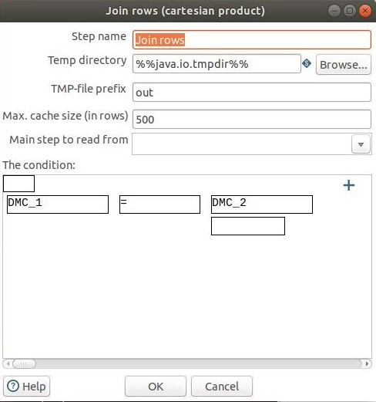
Join rows

Slide 25
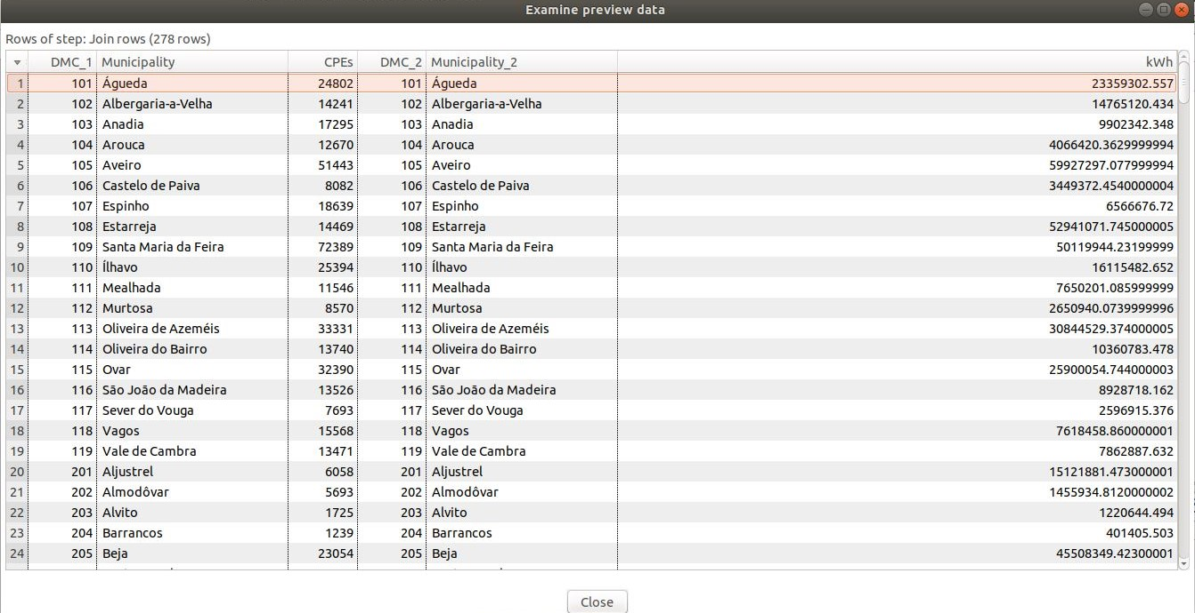
Join rows

Slide 26

Sort rows 3

Slide 27
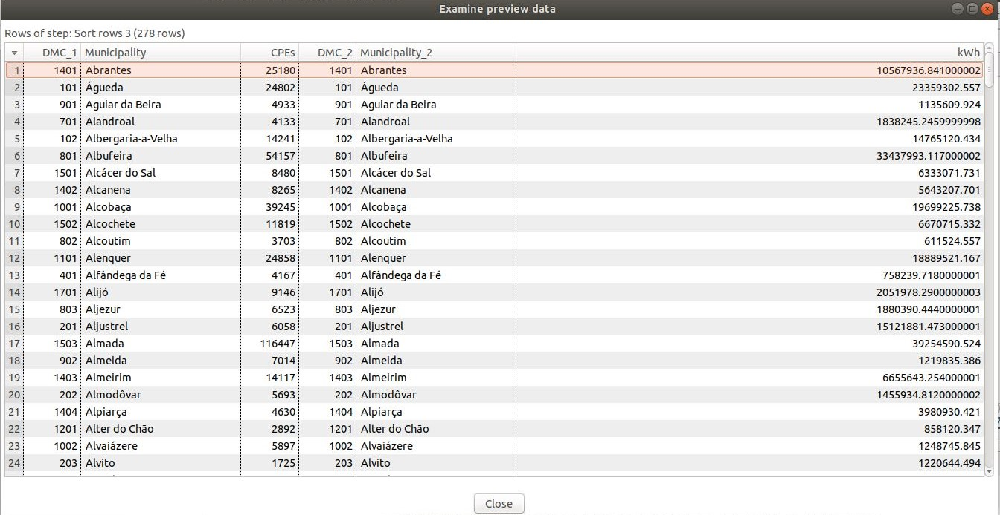
Sort rows 3

Slide 28
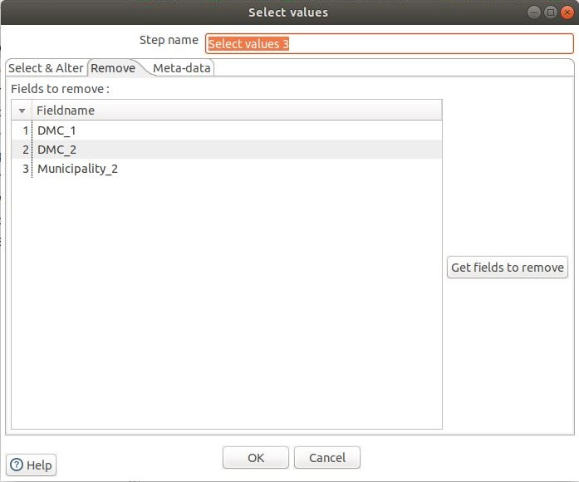
Select values 3

Slide 29
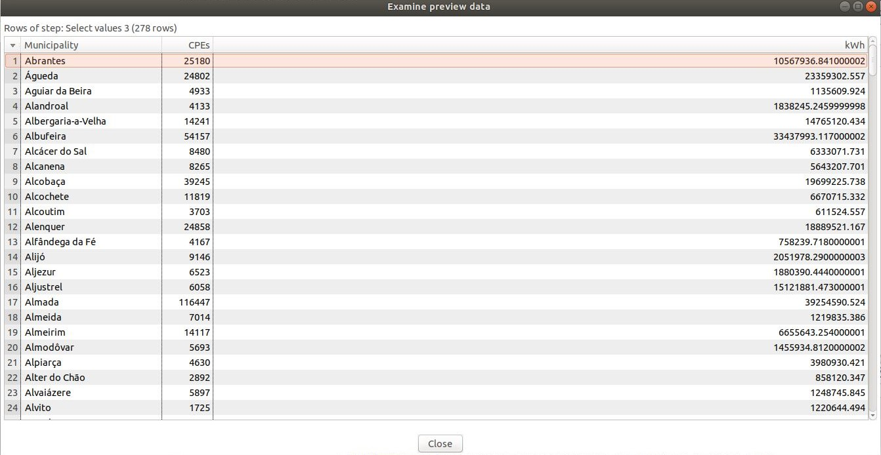
Select values 3

Slide 30
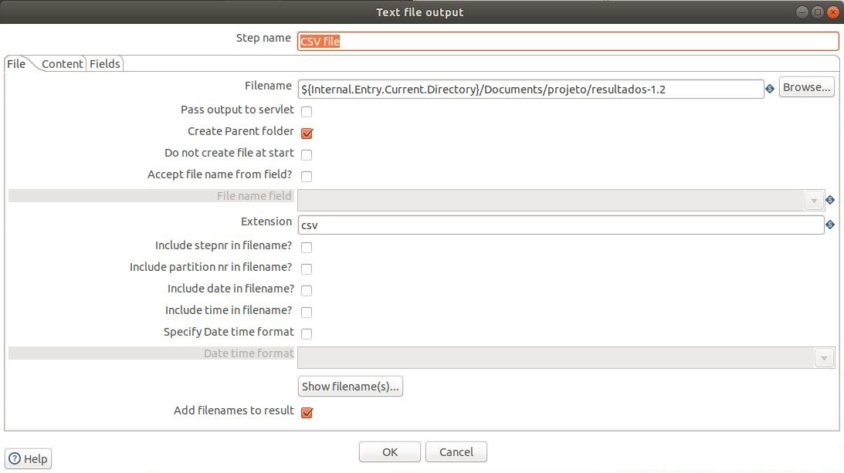
CSV file

Slide 31
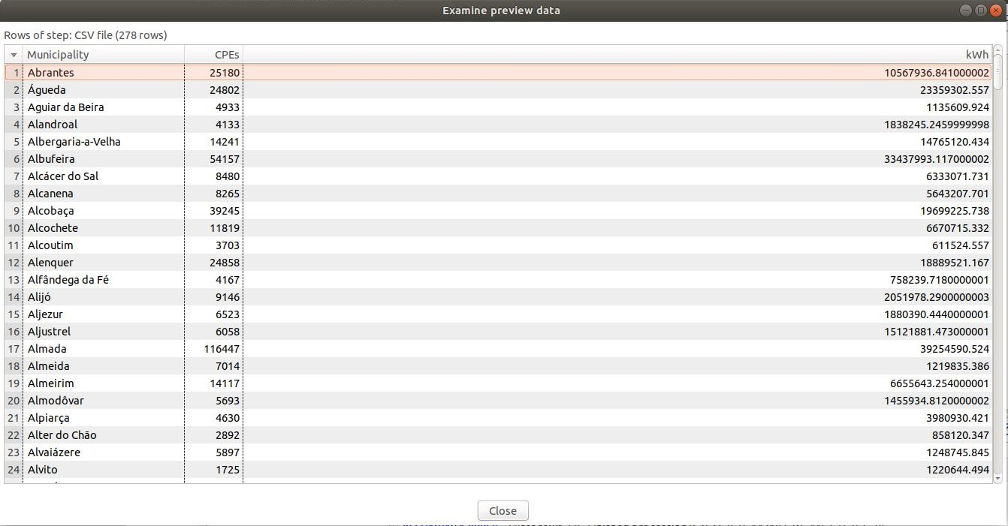
CSV file

Slide 32
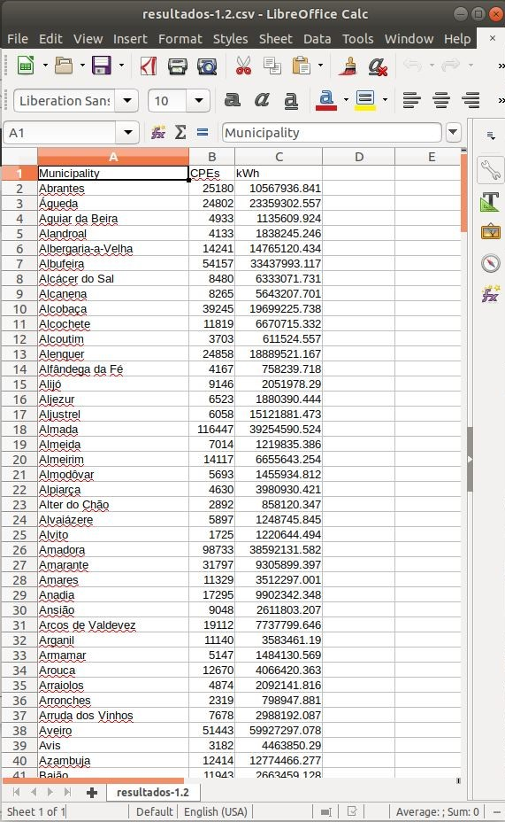
Output file

Slide 33
02

Slide 34
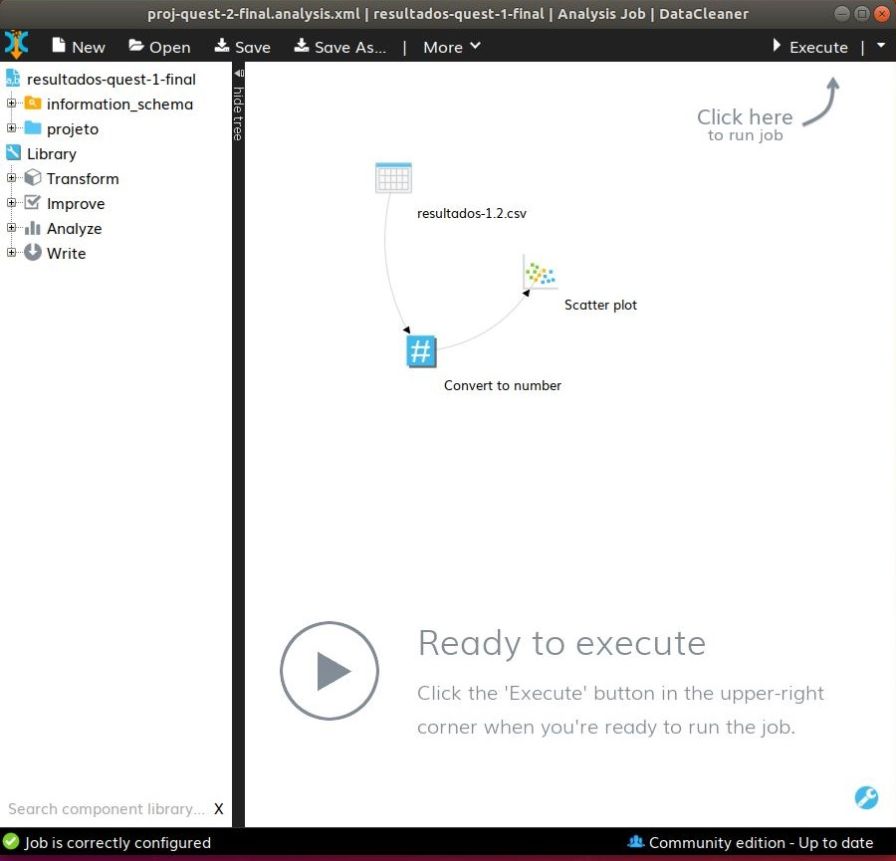
Analysis Job

Slide 35
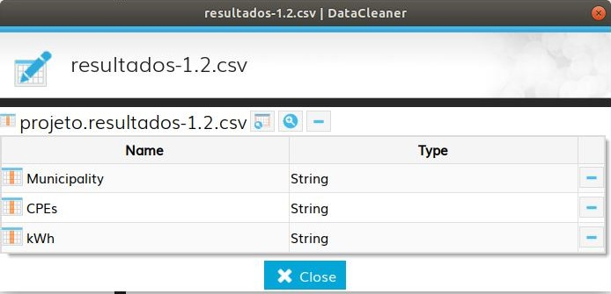
CSV configuration

Slide 36
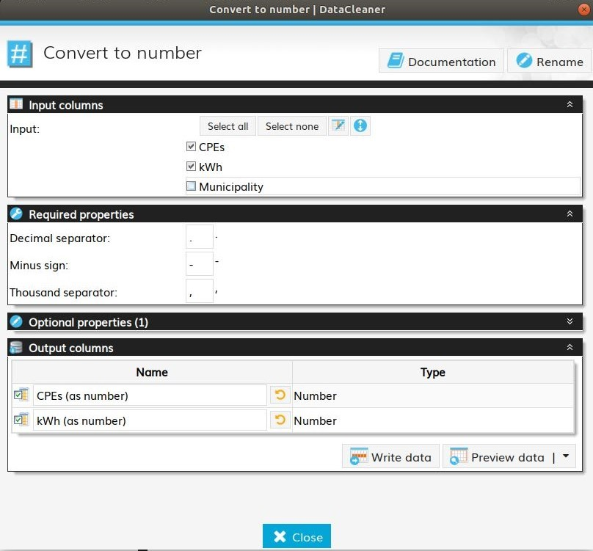
Convert to number configuration

Slide 37
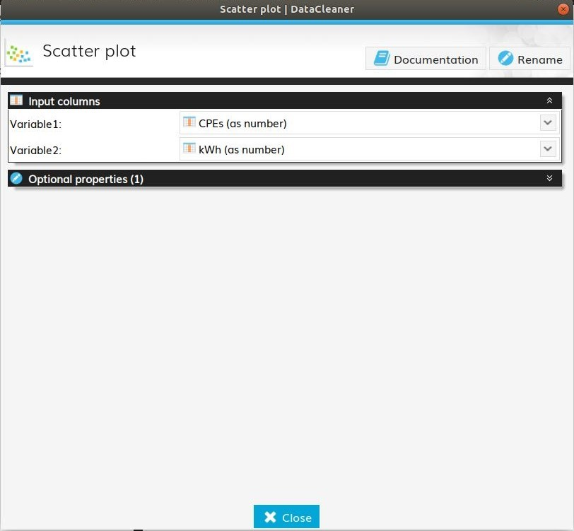
Scatter plot configuration

Slide 38
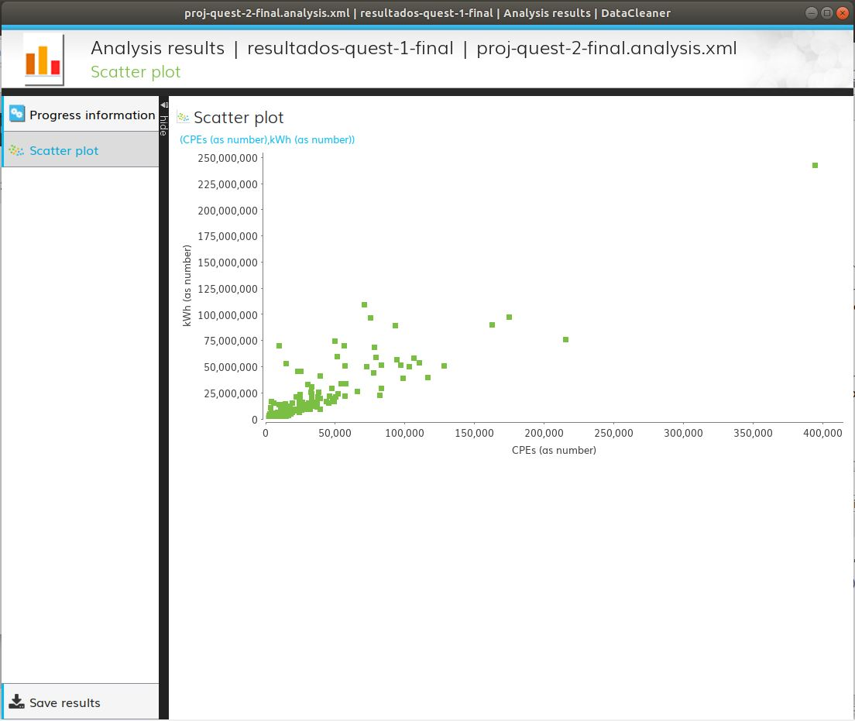
Analysis results

Slide 39
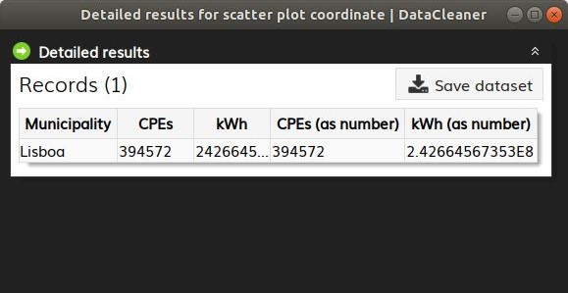
Lisbon

Slide 40

Sintra

Slide 41
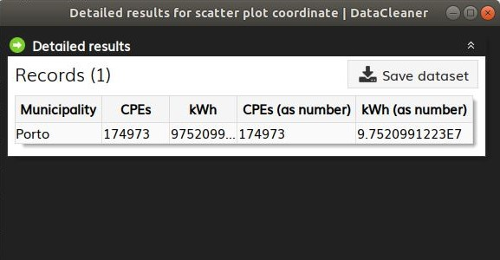
Porto

Slide 42
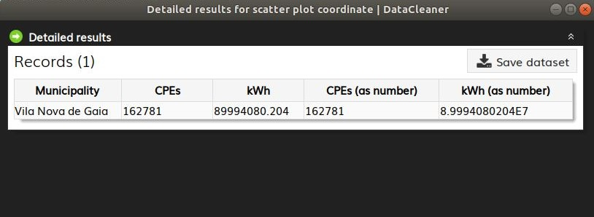
Vila Nova de Gaia

Slide 43
03

Slide 44
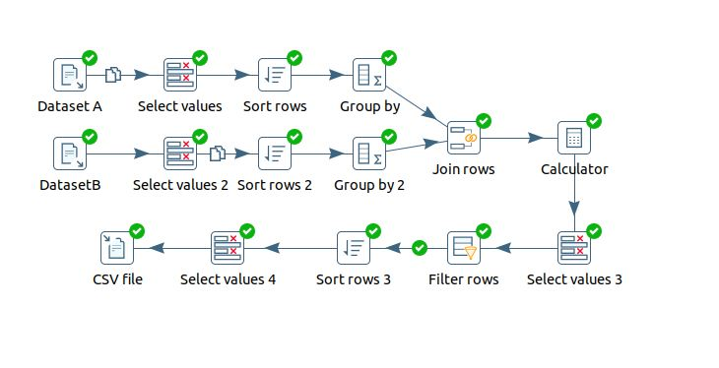
Transformation

Slide 45
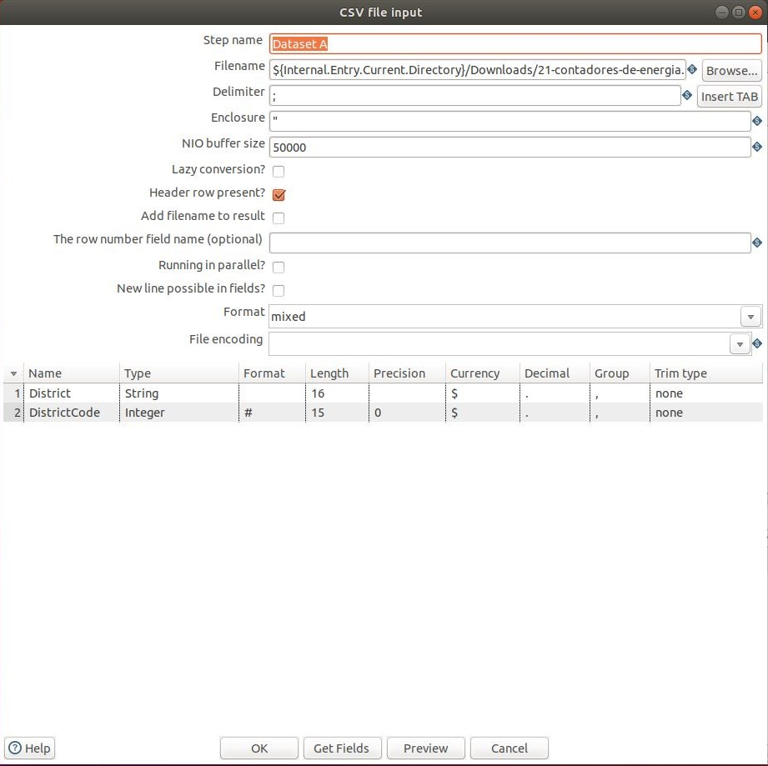
CSV file input

Slide 46
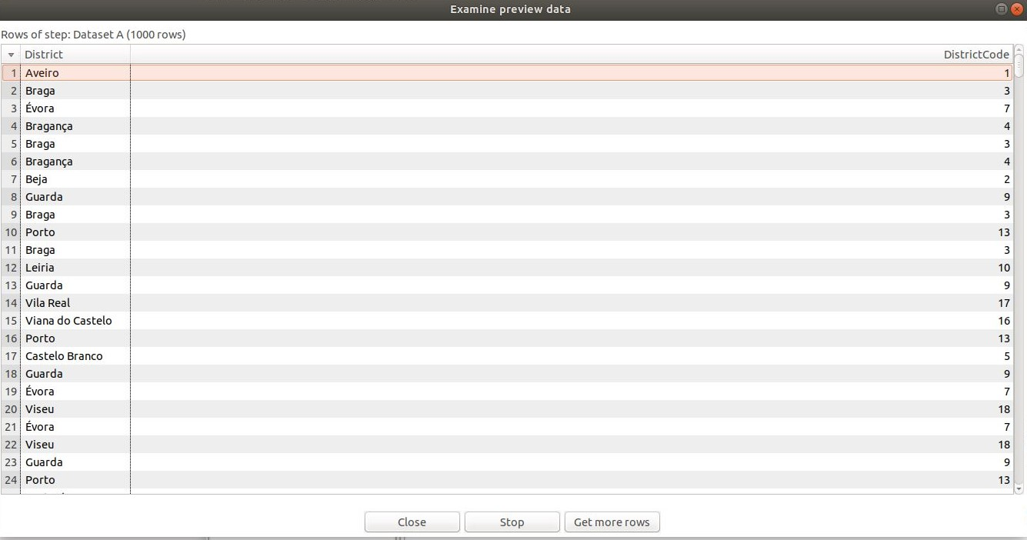
CSV file input

Slide 47
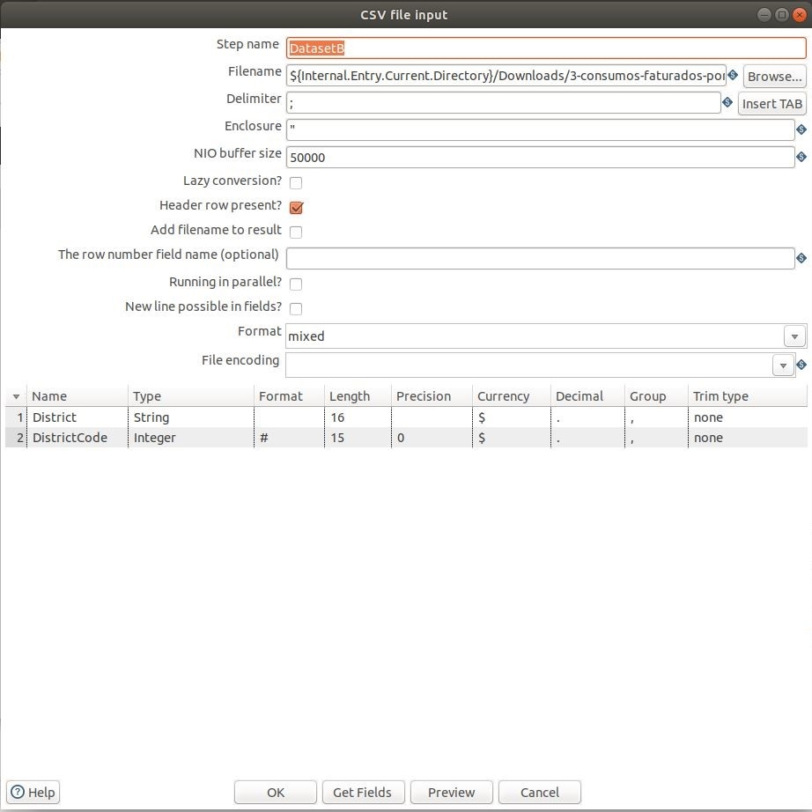
CSV file input 2

Slide 48
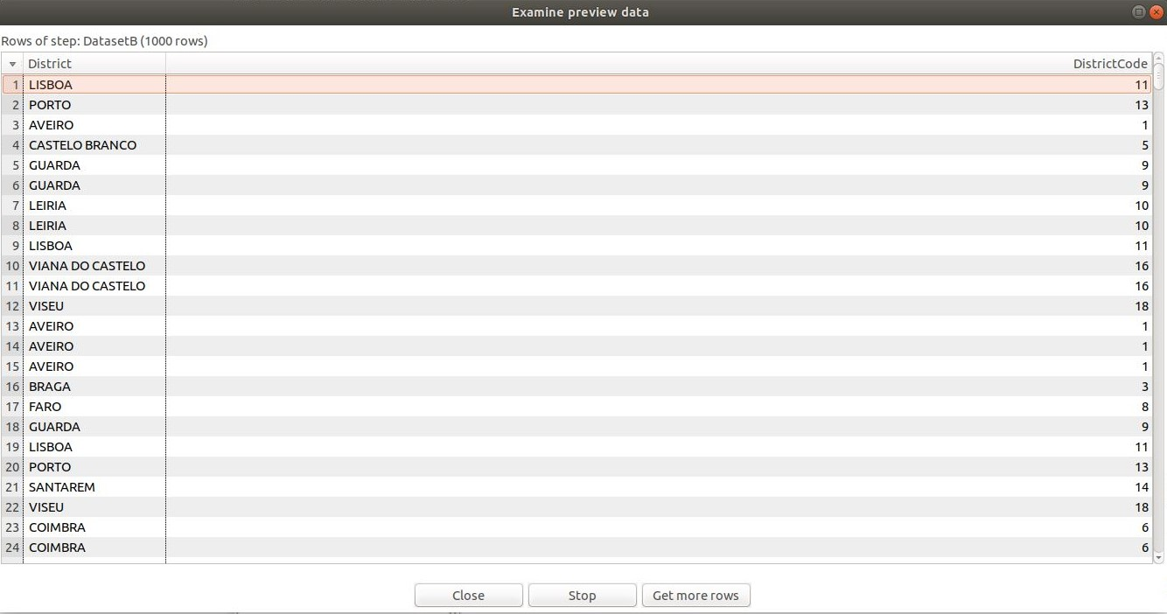
CSV file input 2

Slide 49
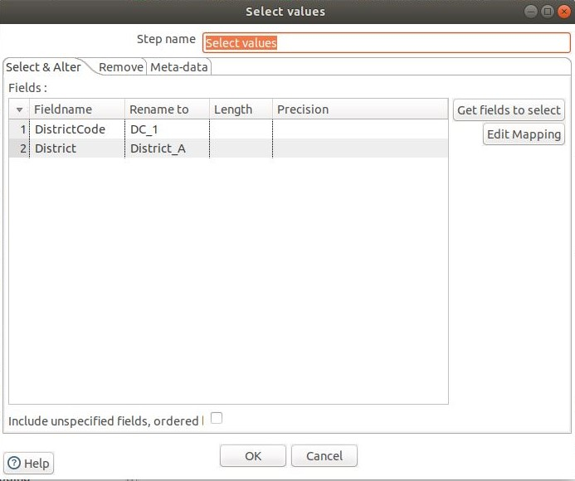
Select Values

Slide 50
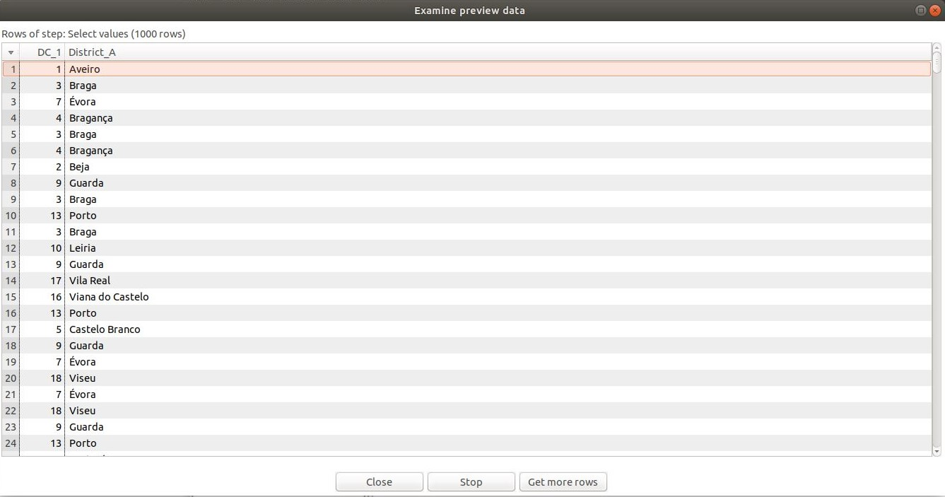
Select Values

Slide 51
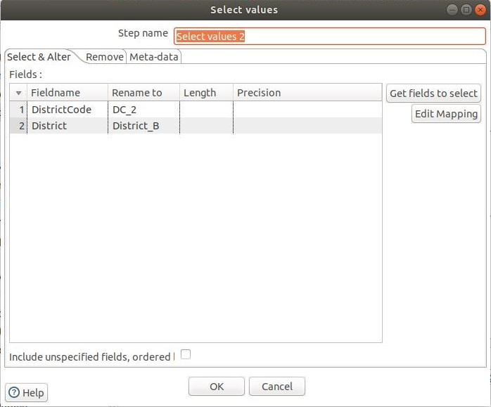
Select Values 2

Slide 52
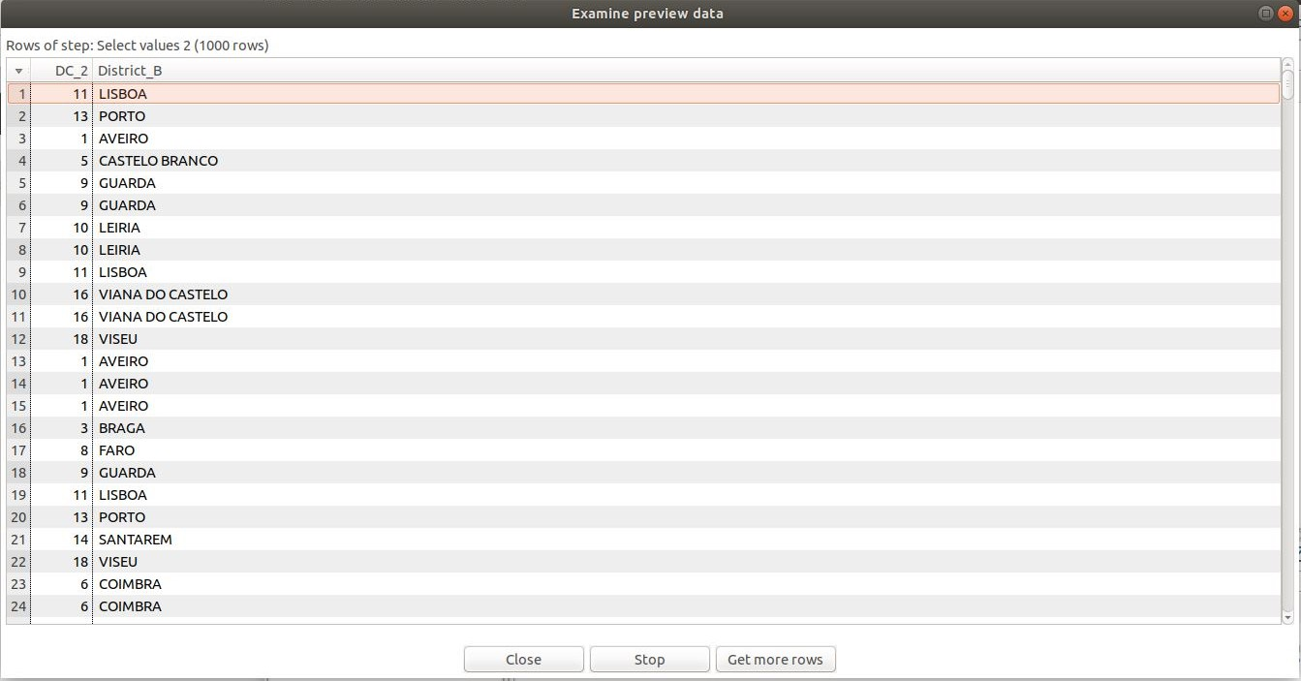
Select Values 2

Slide 53
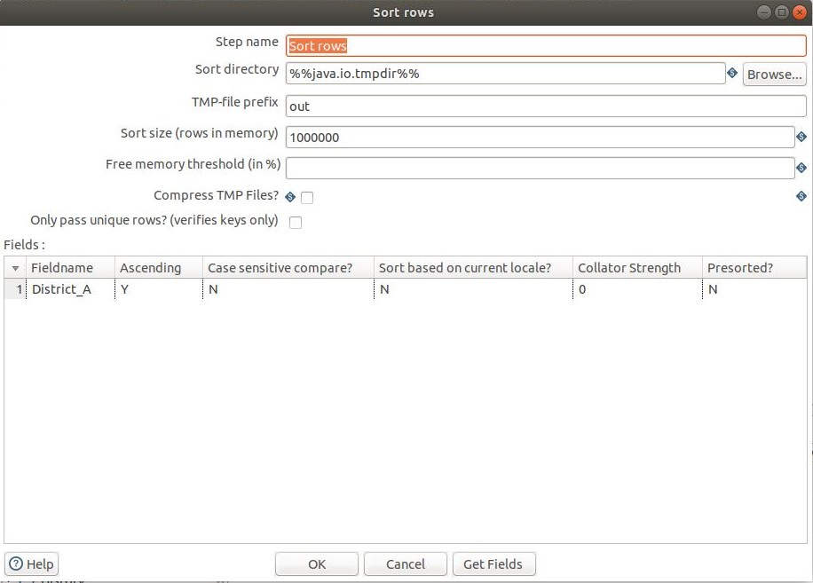
Sort Rows

Slide 54
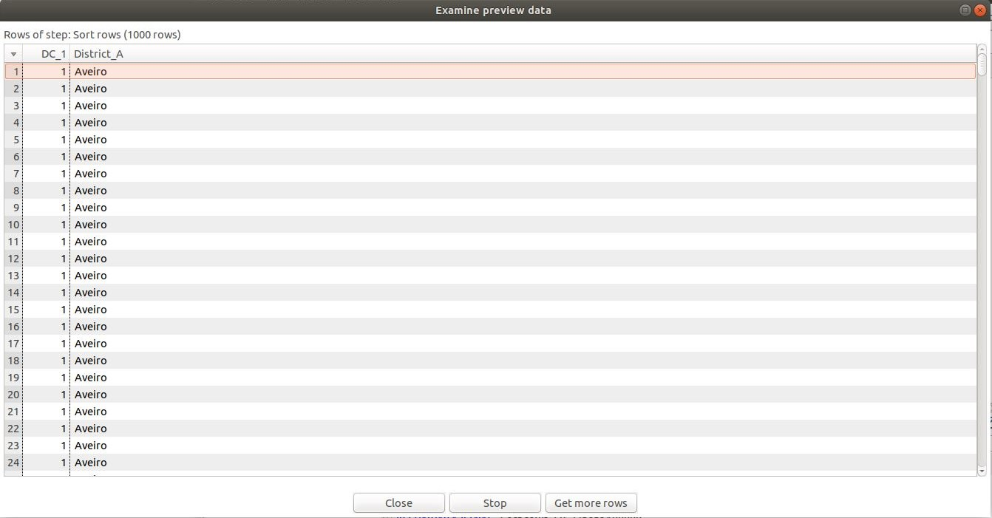
Sort Rows

Slide 55
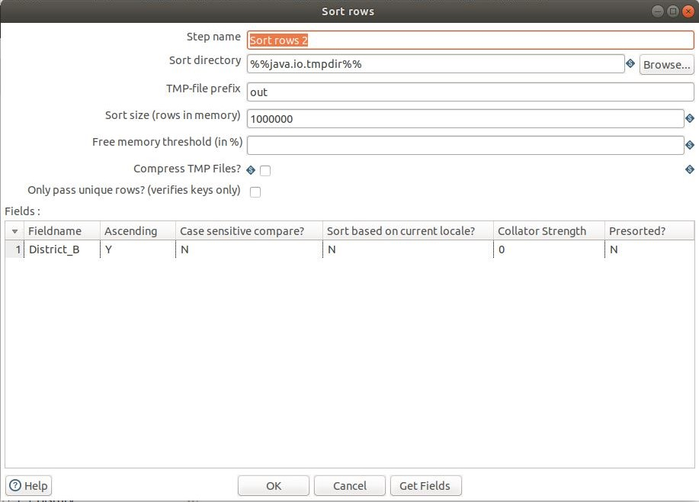
Sort Rows 2

Slide 56
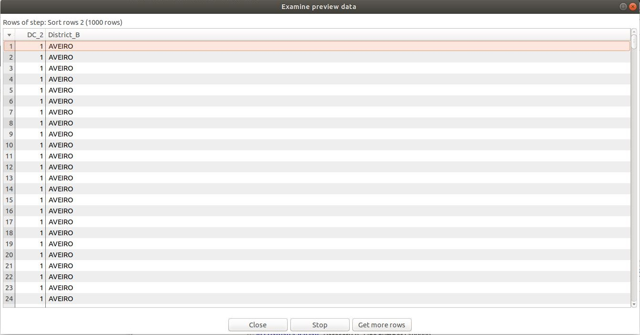
Sort Rows 2

Slide 57
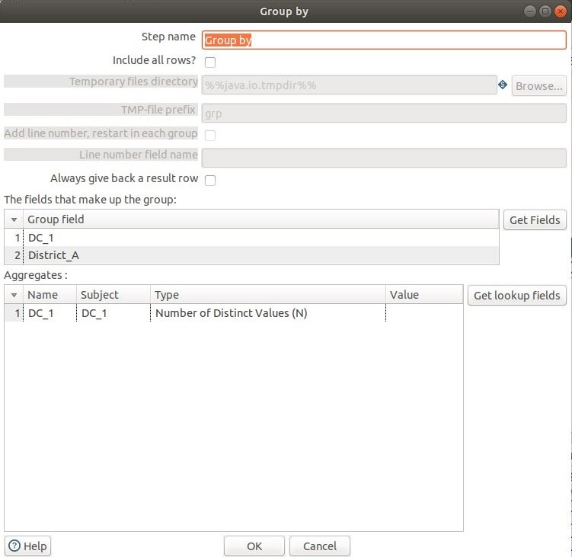
Group By

Slide 58

Group By

Slide 59

Group By 2

Slide 60

Group By 2

Slide 61

Join Rows

Slide 62

Join Rows

Slide 63

Calculator

Slide 64

Calculator

Slide 65

Select Values 3

Slide 66

Select Values 3

Slide 67

Filter Rows

Slide 68

Filter Rows

Slide 69

Sort Rows 3

Slide 70

Sort Rows 3

Slide 71

Select Values 4

Slide 72

Select Values 4

Slide 73

CSV file

Slide 74

CSV file

Slide 75

Output file

Slide 76
04

Slide 77

Script

Slide 78
05

Slide 79

Location dimension

Slide 80

CSV file input

Slide 81

CSV file input

Slide 82

Sort rows

Slide 83

Sort rows

Slide 84

Group by

Slide 85

Group by

Slide 86

Select Values

Slide 87

Select Values

Slide 88

Add Sequence

Slide 89

Add Sequence

Slide 90

Insert/Update

Slide 91

Insert/Update

Slide 92

Time Dimension

Slide 93

CSV File Input

Slide 94

CSV File Input

Slide 95

Sort Rows

Slide 96

Sort Rows

Slide 97

Group by

Slide 98

Group by

Slide 99

Select Values

Slide 100

Select Values

Slide 101

Add Sequence

Slide 102

Add Sequence

Slide 103

Insert/Update

Slide 104

Insert/Update

Slide 105

Voltage Dimension

Slide 106

CSV File Input

Slide 107

CSV File Input

Slide 108

Sort rows

Slide 109

Sort rows

Slide 110

Group By

Slide 111

Group By

Slide 112

Select Values

Slide 113

Select Values

Slide 114

Add Sequence

Slide 115

Add Sequence

Slide 116

Insert/Update

Slide 117

Insert/Update

Slide 118
06

Slide 119

Fact Table

Slide 120

CSV File Input

Slide 121

CSV File Input

Slide 122

Database Lookup

Slide 123

Database Lookup

Slide 124

Database Lookup 2

Slide 125

Database Lookup 2

Slide 126

Database Lookup 3

Slide 127

Database Lookup 3

Slide 128

Select Values

Slide 129

Select Values

Slide 130

Insert/Update

Slide 131

Insert/Update

